Slide 1



Big Data Analysis
Presentation for final project
Made by: Mukhamedali Nurislam, Mukashev Rashid, Makulbek Alisher

Slide 2
Introduction:
Dataset & Objective
In this project we work with two datasets.
The first dataset contains e-commerce transactions: orders, revenue, profit, dates and products.
The second dataset contains customer information: age, gender, income, job and work indicators.
The main goal of the project is to understand customer behavior and sales patterns.
We also want to predict future sales and customer interest in products.

Slide 3
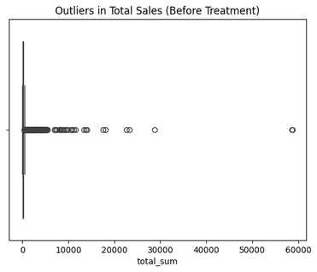
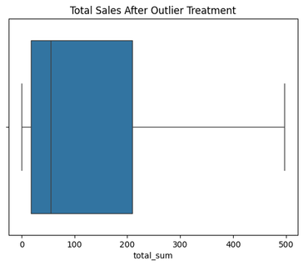



Task 1: Data Loading and Cleaning
First, we loaded both datasets and checked their structure.
We looked at columns, data types and basic information and found missing values, duplicates and incorrect data types.
Missing values were filled using mean or mode, or removed, duplicates were removed to avoid repeated transactions.
We also fixed logical errors, for example negative profit or incorrect dates.
Categorical values were normalized
After cleaning, we received two clean datasets ready for analysis.

Slide 4
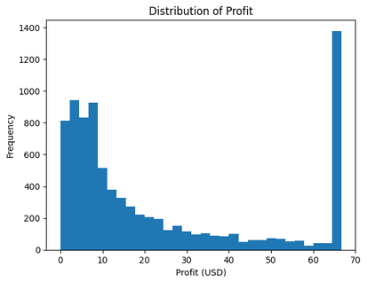
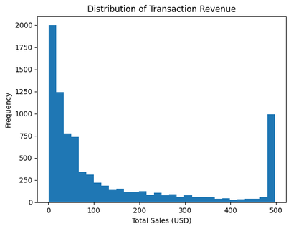
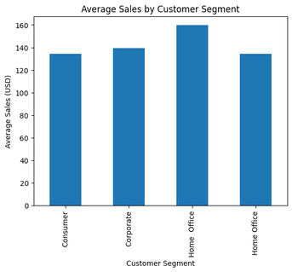
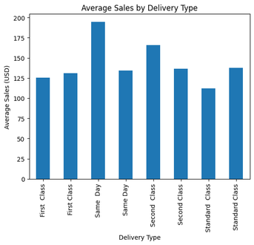
Task 2: Exploratory Data Analysis (EDA)
After cleaning, we explored the data using descriptive statistics.
We calculated mean, median, standard deviation and quantiles.
The analysis helps us understand how sales and profit are distributed.
We also compared different customer segments and categories.
EDA gives insights before modeling.

Slide 5
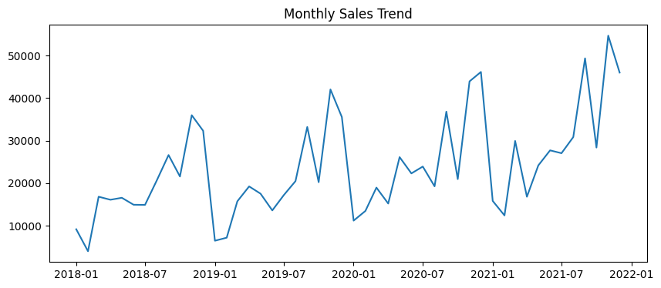
EDA — Key Insights
From the visualizations we see clear patterns.
Some customer segments generate more revenue than others.
Sales change over time and show visible trends.
Profit distribution is not symmetric, and there are outliers.
These results help us choose correct models for the next steps.

Slide 6
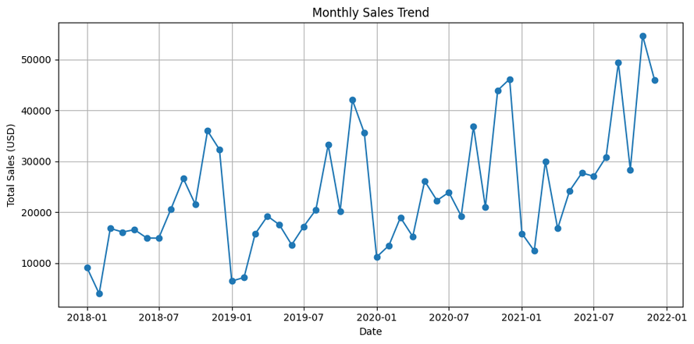
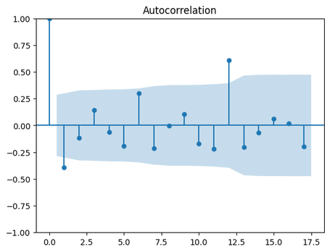
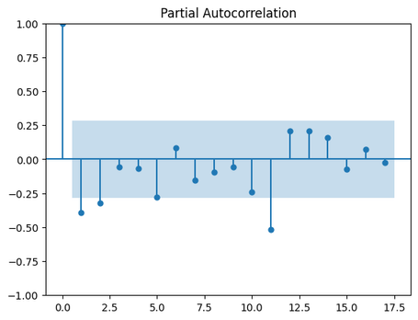
Task 3: Time Series Analysis
We used transactional data for time series analysis.
Sales were aggregated by time (monthly or daily).
First, we tested stationarity using the ADF test.
Then we plotted ACF and PACF to understand time dependence.
Based on these plots, we selected an ARIMA model.

Slide 7
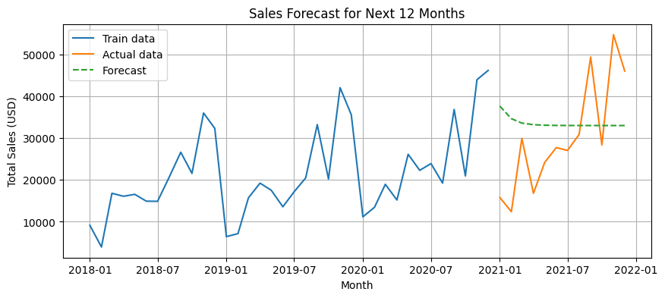
Forecasting Results
The ARIMA model was used to forecast the next 12 periods.
The forecast shows expected future sales values.
We evaluated model quality using RMSE and MAE.
The errors are acceptable, so the model is reliable for short-term forecasting.
This model can help businesses plan inventory and demand.

Slide 8
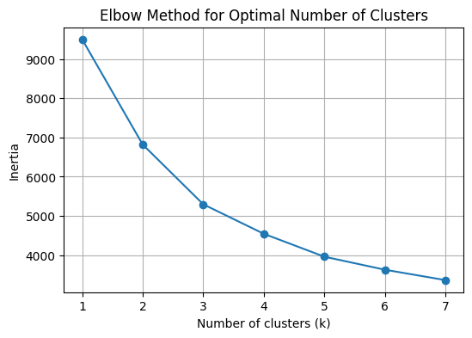
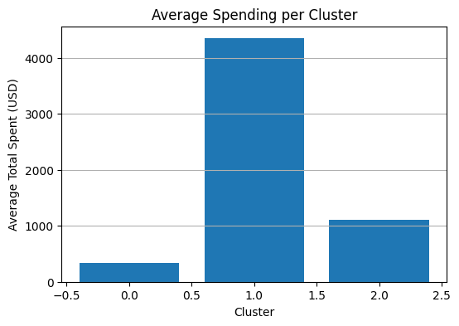
Task 4: Customer Segmentation
k = 2, silhouette score = 0.495 k = 3, silhouette score = 0.330 k = 4, silhouette score = 0.321 k = 5, silhouette score = 0.323 k = 6, silhouette score = 0.185
In this task we performed customer segmentation.
We selected numerical and categorical customer features.
Categorical variables were encoded.
Numerical features were scaled.
We applied the hierarchial clustering algorithm.

Slide 9
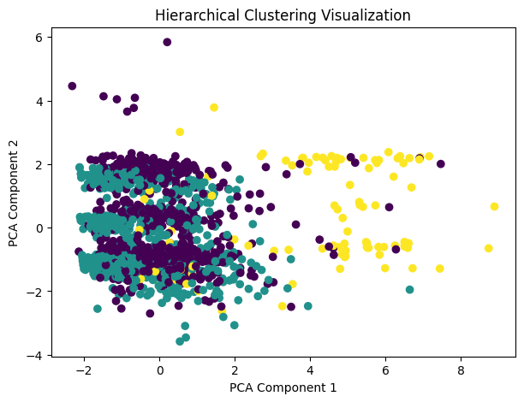
Cluster Interpretation
Each cluster represents a different type of customer.
Some clusters have higher income and higher purchases.
Other clusters are more price-sensitive or inactive.
This segmentation helps businesses understand customers better.
It can be used for targeted marketing and personalized offers.

Slide 10
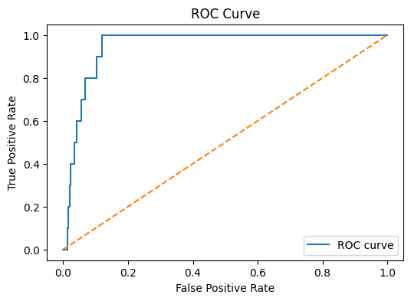

Task 5: Predictive Modeling
In this task we built a classification model.
The goal is to predict if a customer will buy a specific product category.
We created a binary target variable based on past purchases.
Transaction data was aggregated to customer level.
We used customer attributes and aggregated features as inputs.
We trained a classification model.
The data was split into train and test sets.
We evaluated the model using several metrics.
Accuracy shows overall correctness.
Precision and recall show prediction quality.
F1-score balances precision and recall.
ROC-AUC shows how well the model separates classes.
The results show that the model performs reasonably well.

Slide 11

Task 6: Business Interpretation
The data shows clear customer behavior patterns.
Some customer characteristics strongly influence product interest.
Time series analysis shows sales trends and seasonality.
Customer segmentation helps identify valuable customer groups.
Predictive modeling helps target customers more effectively.
The models are not perfect, but they are useful for decision-making.

Slide 12
Conclusion
In this project, we analyzed real e-commerce data using Python.
First, we cleaned the data by fixing missing values, duplicates, wrong data types, and logical errors.
This step was very important to make the data ready for analysis.
Then we explored the data using statistics and visualizations.
EDA helped us understand sales distribution, customer segments, and time trends.
We used time series analysis to study sales over time and forecast future values.
The model shows reasonable accuracy and can be used for short-term planning.
Customer segmentation helped us group customers with similar behavior.
Predictive modeling helped us estimate customer interest in products.
Overall, the project shows how data analysis can support better business decisions, such as marketing, customer targeting, and sales forecasting.

Slide 13
THANK YOU FOR YOU ATTENTION

